Slide 1
Digital Image Processing Final Project
高安全性的医学图像不可见数字水印
生成方法研究与配套软件开发
High security blind-watermark for medical images
杨鸿嘉
专业：19信息工程

Slide 2
·CONTENTS·
1.
Background
3.
My plan
2.
Related work
4.
Challenge

Slide 3
PART 1
Background

Slide 4
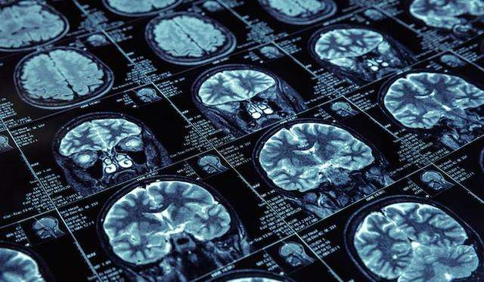
Background
Telemedicine :
Convenient for remote health care institutions
Cause security and data protection risks
Functions of watermark:
Ownership verification
Content falsification
Patient information encryption
Blind-watermark:
Can not be seen in the image
Especially important for medical image

Slide 5
Background
Requirements for blind-watermark
Fidelity
Robustness
Capacity
Do not affect doctor's judgment
ROI & NROI
Image damage
Image Degeneration
Transmission error
Information length
logo
Information compression

Slide 6
PART 2
Related work

Slide 7

Main process for blind-watermark
domain data
Original image
Watermark
image
Transform
Spatial domain: LBS
Transform domain: DFT DCT DWT
DWT-SVD
ROI&NROI segmentation:
deep learning threshold
Histogram
Pre process
mapping: Arnold Hilbert Fibonacci
coding:BCH
signature: MD5 Hash
Watermark
(logo,text)

Slide 8
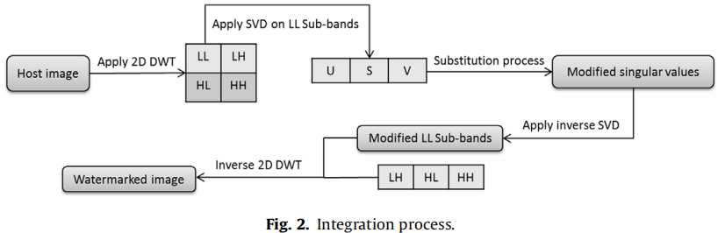
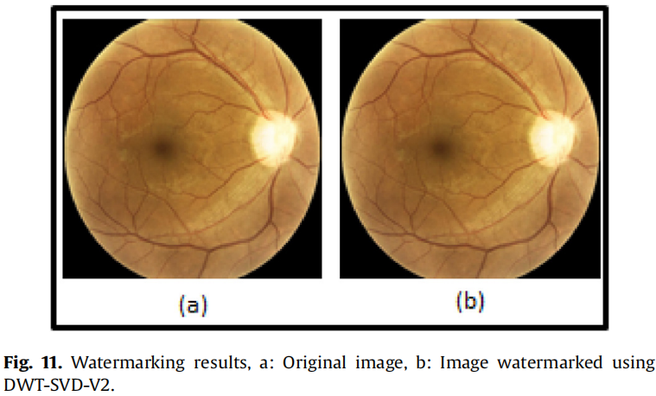
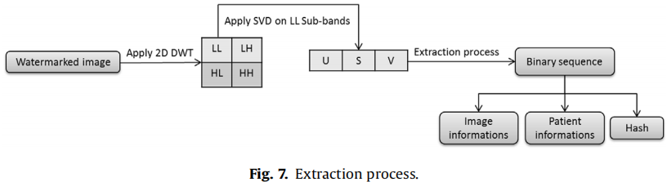
Related work
DWT-SVD based blind-watermark
Zermi N, Khaldi A, Kafi R, et al. A DWT-SVD based robust digital watermarking for medical image security[J]. Forensic Science International, 2021, 320: 110691.

Slide 9
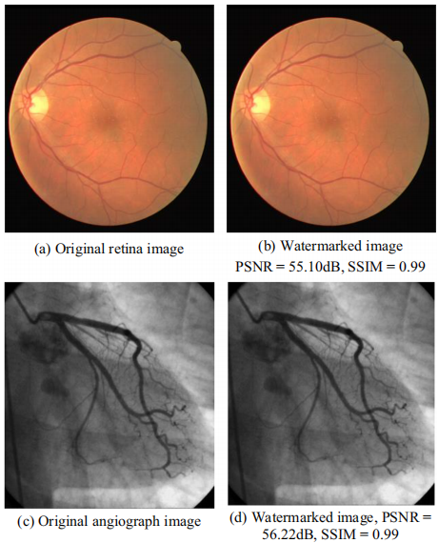
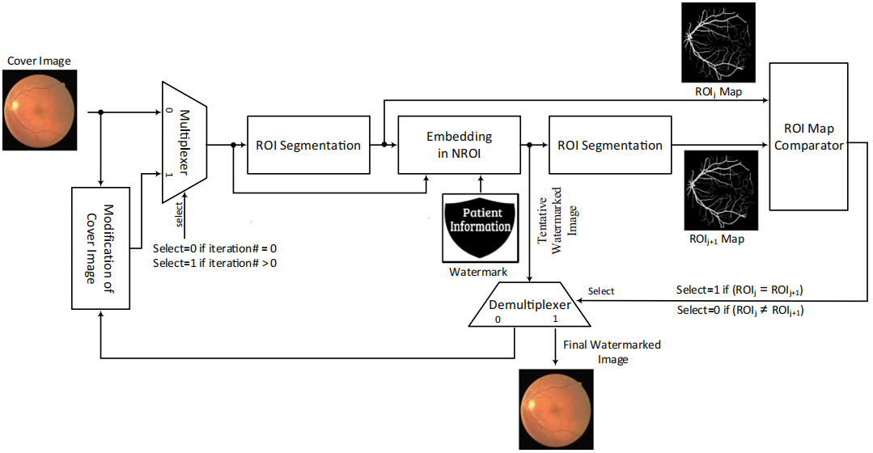
Related work
ROI segmentation
Zarrabi H, Emami A, Khadivi P, et al. BlessMark: a blind diagnostically-lossless watermarking framework for medical applications based on deep neural networks[J]. Multimedia Tools and Applications, 2020, 79(31): 22473-22495.

Slide 10
PART 3
My plan

Slide 11
Anticipate result
01
02
03
High robustness
Fast speed
Batch operation &
human computer interaction
anti-interference
simulation for damage
improve current algorithm
reduce algorithm complexity
GUI

Slide 12
Project plan
1.
Blind-watermark algorithm implementation
(1-2 week)
Spatial domain
Transform domain
ROI segmentation
Plan and
schedule
2.
Robustness verify (1 week)
Noise Filtering Interpolation
Transmission error
3.
GUI development (1 week)
Batch processing
Multiple modes
Analysis

Slide 13
PART 4
Challenge

Slide 14
Challenge
B
A
A
Formula and algorithm:
Mathematical derivation
D
B
Medical image ROI segmentation
C
C
Transform domain watermark:
Hard to analyse
D
Improvement for the algorithm

Slide 15

References
[1] Zarrabi H, Emami A, Khadivi P, et al. BlessMark: a blind diagnostically-lossless watermarking framework for medical applications based on deep neural networks[J]. Multimedia Tools and Applications, 2020, 79(31): 22473-22495.
[2] Zermi N, Khaldi A, Kafi R, et al. A DWT-SVD based robust digital watermarking for medical image security[J]. Forensic Science International, 2021, 320: 110691.
[3] Kahlessenane F, Khaldi A, Kafi R, et al. A DWT based watermarking approach for medical image protection[J]. Journal of Ambient Intelligence and Humanized Computing, 2021, 12(2): 2931-2938.
[4] 李九高. 医学CT图像数字水印算法的研究[D].南京邮电大学,2013.
[5] 张正光. 基于时频联合变换域的盲水印算法研究[D].东北大学,2014.

Slide 16
THANK YOU
PLEASE GIVE ME AS MUCH CRITICISM AS POSSIBLE

Slide 17
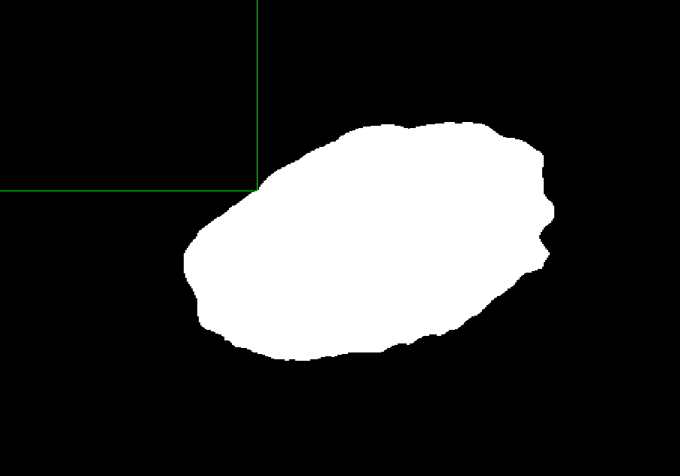
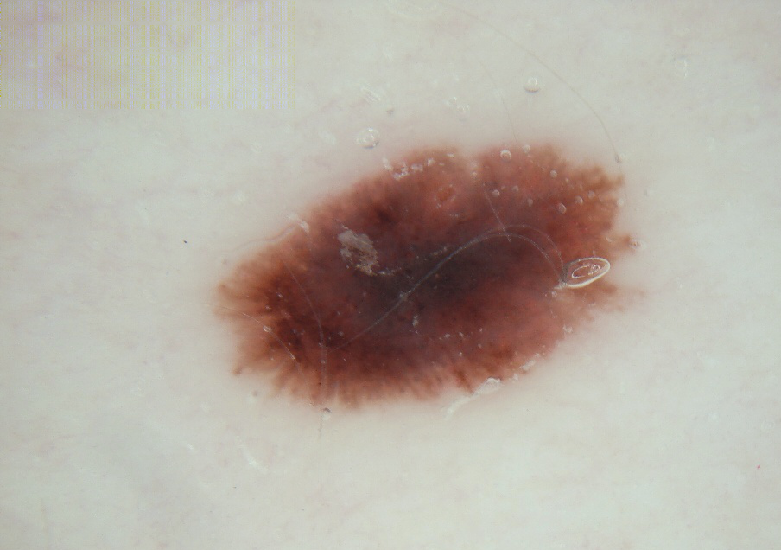

Slide 18


